Slide 1


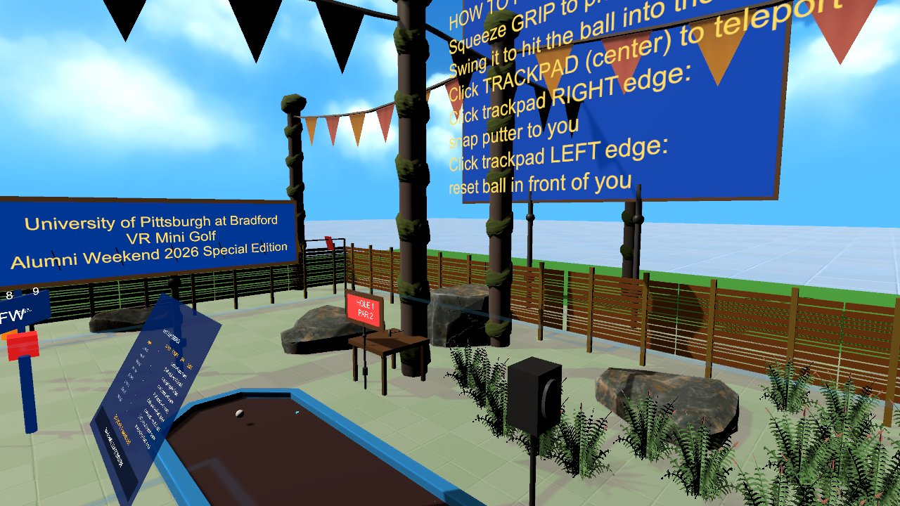

Virtual Reality
Final exam and final GitHub submission
Wednesdays at 6:00pm
CIST 1423 - 2010 VIRTUAL REALITY PROGRAMMING AND TECHNOLOGY
Final exam online via Canvas during finals week

Slide 2



Agenda
Final repo
Exam review
After the course
Everything that must be in it
Ch. 1–9 in one page
Where to go next

Slide 3

Today
By the end of class you can…
Submit a complete final repo
Tonight's plan
1
Before
Push the final repo
Review Ch. 1–9 for the final exam
2
Exam
Online via Canvas
After
Keep building
CIST 1423 — Week 16 — Final Exam (finals week)

Slide 4
Final GitHub submission checklist
From the syllabus. Missing items cost points even if the app is great.
Item | What it means | File / folder
Unity project files | Assets/, Packages/, ProjectSettings/ (no Library/, Temp/, Builds/) | .gitignore does this
Final VR/AR build | Zipped Windows build or APK as a GitHub Release, or a live WebXR URL | Releases / README link
Design log | Dated entries from concept to final | DESIGN-LOG.md
Playtest reports | Week 14 report + what you fixed | PLAYTEST.md
Final reflection | What you built, learned, and would change | REFLECTION.md
README | What it is, screenshots, how to run it, controls | README.md
CIST 1423 — Week 16 — Final Exam (finals week)

Slide 5






Exam review: Ch. 1–9 in one page
The final covers everything. These are the big ideas per chapter.
Ch. 1–2
Ch. 3
Ch. 4 + WebXR
VR / AR / MR, 6DOF, stereo
Editor, components, colliders, materials, prefabs, lighting
XR Plug-in Management, OpenVR vs OpenXR
Rig, teleport, grab, actions not buttons
AR Session, XR Origin, planes, raycasts, anchors
WebXR hit-test, the ECS pattern
Ch. 5–6
Ch. 7–8
Ch. 9
No-code vs C# interaction, Animator
AR menu: place + swap prefab
Spatial audio, particles, fog
Hands, gaze, multiplayer ownership + sync
Comfort, performance, audience, UX
Branches, PRs, reviews
CIST 1423 — Week 16 — Final Exam (finals week)

Slide 6



Where to go next
Everything we used this semester is free and open.
Unity
Web
Community
Unity Learn: VR Development pathway
Meta XR SDK samples for Quest
Meta's WebXR showcases + IWSDK
This repo: Meta-WebXR-Samples/
Help staff the VR Lab at campus events
Game jams: build something in 48 hours
CIST 1423 — Week 16 — Final Exam (finals week)

Slide 7
Check your understanding
Answer with a partner first, then we'll compare.
Q1
Q2
Which folders must never be committed from a Unity project?
Name the four Markdown files in the final repo.
CIST 1423 — Week 16 — Final Exam (finals week)
Notes:
Answers:
Q1. Which folders must never be committed from a Unity project?
Library/, Temp/, Obj/, Builds/, Logs/, UserSettings/.
Q2. Name the four Markdown files in the final repo.
README.md, DESIGN-LOG.md, PLAYTEST.md, REFLECTION.md.

Slide 8

Thank you! Final steps
Push the final repo: project, build, DESIGN-LOG.md, PLAYTEST.md, REFLECTION.md, README.md
Take the final exam on Canvas during finals week
Keep building: bring your project to the next Alumni Weekend
CIST 1423 — Week 16 — Final Exam (finals week)

